Slide 1



BUY
Midea Group Ltd. (SZSE:000333)
24.5% Upside
Target Price :￥88.8
Closing Price :￥71.32
“Braving the Waves” - Midea

Slide 2
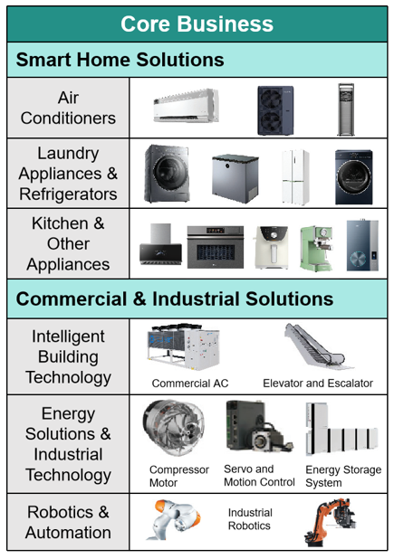


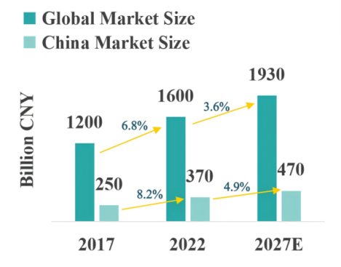


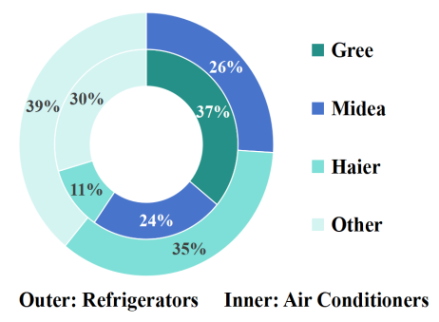
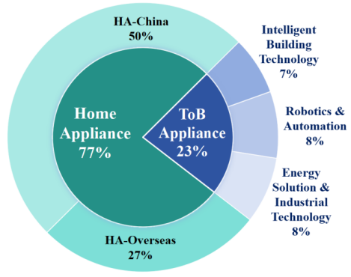
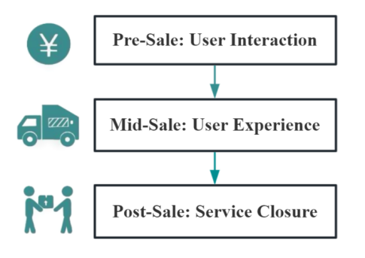
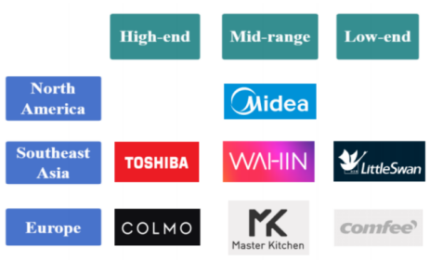

Business Overview & Competitive Positioning
Business Overview
Competitive Positioning
1
company overview
employees
achieved for 9 consecutive years
Comparable Companies
Market Dynamics
>190k
In the home appliance industry, Midea competes fiercely with Gree and Haier.
dual listing
2
history and expansion
1968
Established
1993
Midea Appliances goes public
2024
Secondary listing
(HKEX)
2013
Achieves comprehensive
listing(SZSE)
Establishing differentiated competitive advantages: covering various market segments from economy to high-end products.
Customer Loyalty and Strategic Partnerships
3
key operating segments
Smart Home Solutions provides a variety of household appliances, including air conditioners, refrigerators, washing machines, and kitchen appliances.
Commercial & Industrial Solutions includes Energy Solutions & Industrial Technology, Intelligent Building
Technology, and Robotics & Automation.
OVERVIEW
THESIS #1
THESIS #2
THESIS #3
ESG
FINANCIALS
RISKS
VALUATION
APPENDIX

Slide 3
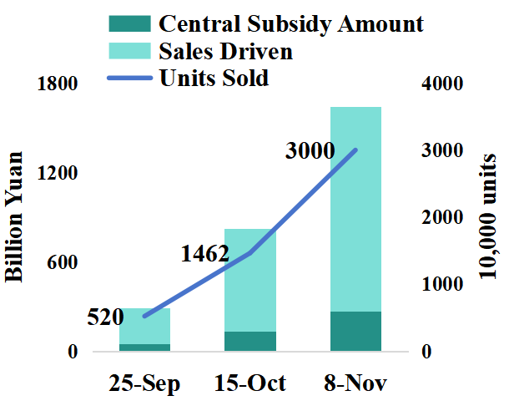
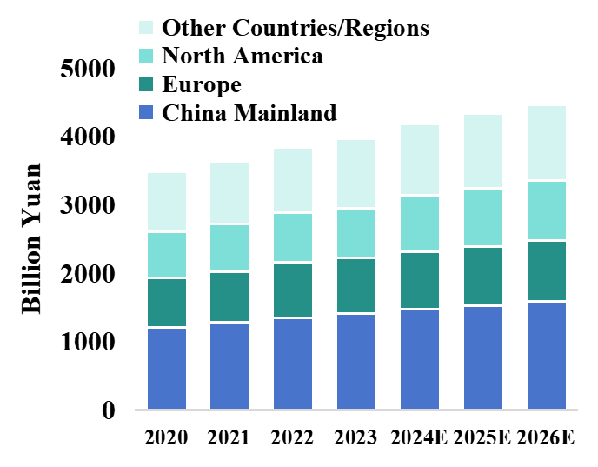
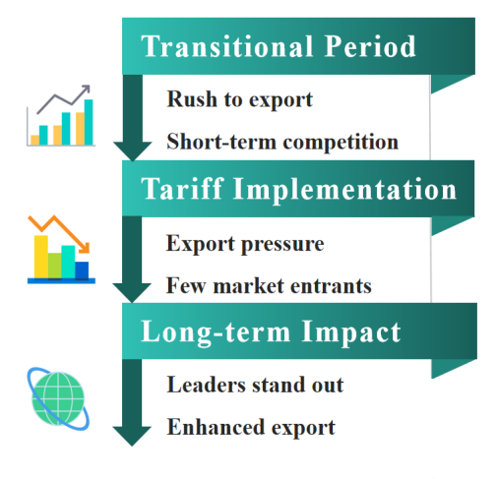
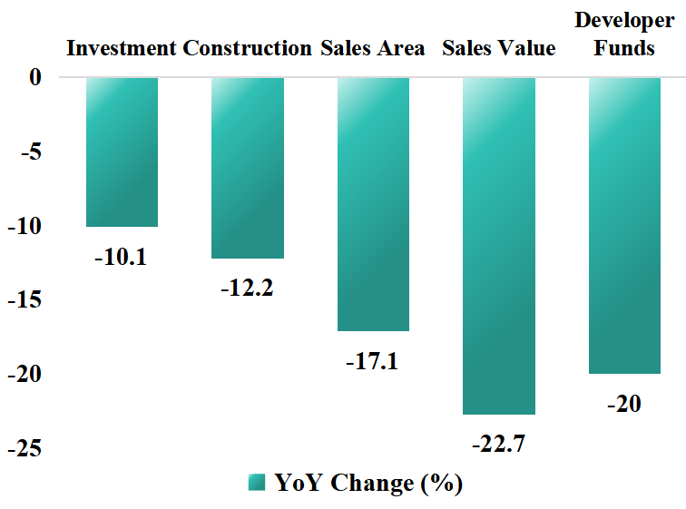
Industry Overview
- Positive
- Positive
- Negative
- Mixed
Impact of the Trade-In Policy
Strong Overseas Demand and Continued Rapid Growth in Appliance Exports
Uncertainty in the Real
Estate Market
Uncertainty in Exports Due
to the U.S. Election
May come with high tariffs
The real estate market is sluggish.
Fewer new home appliance purchases
Chinese home appliance companies possess strong globalcompetitiveness.
Inventory backlog
Government provided a total subsidy of 150 billion yuan
China's exports to Latin America, Southeast Asia, the Middle East, and Africa have seen strong growth in recent years.
Sales of major appliances have been significantly boosted as a result.
High tariffs bar other competitors' exports
Q3 2024 EXPORT : 10.4%
Industry leader Midea has stronger resistance to high tariffs.
OVERVIEW
THESIS #1
THESIS #2
THESIS #3
ESG
FINANCIALS
RISKS
VALUATION
APPENDIX

Slide 4


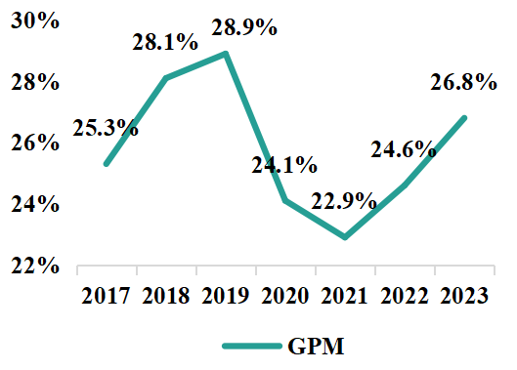

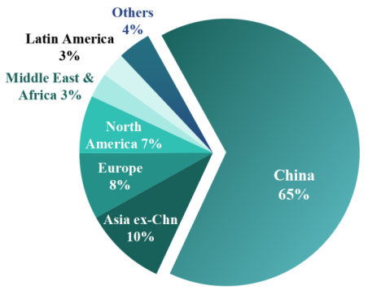
Investment Summary
#1: Midea has Strong Global Competitiveness
Digital Transformation and Strong Bargaining Power |  | Dual Listing Broadens Financing Channels and Enhances International Influence
Sino-American trade war
Funds | Raised 8 billion Hong Kong dollars
Investors | Attract more international investor attention
Disclosure | Improve the company's governance structure
Value | Enhance the company's overall value
Successfully shift tariffs to
customers
#2: Midea has Continuous Business Revenue Growth Potential
Maintained a gross margin of about 28%
Global Production Base Layout and Localization of Supply Chain Management
#3: Midea has Exceptional R&D Innovation Capability
16
>35K
Operating costs | Transportation costs
8% | 5%-7%
The number of countries covered by Midea
Number of overseas employees
17
22
Supply chain efficiency | Inventory turnover days
10% | ≈ 35 day
Overseas R&D centers
Global manufacturing bases
OVERVIEW
THESIS #1
THESIS #2
THESIS #3
ESG
FINANCIALS
RISKS
VALUATION
APPENDIX

Slide 5
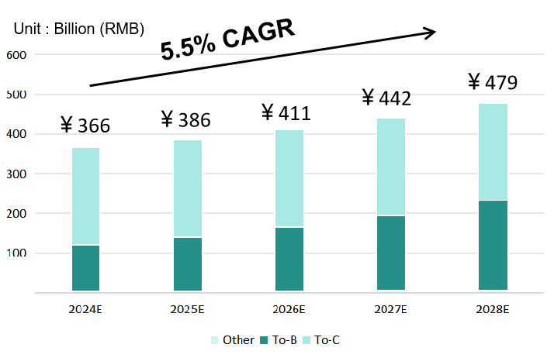
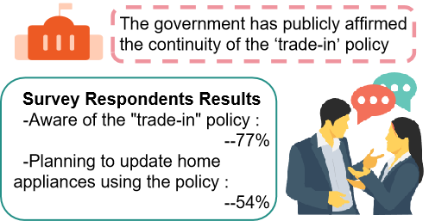
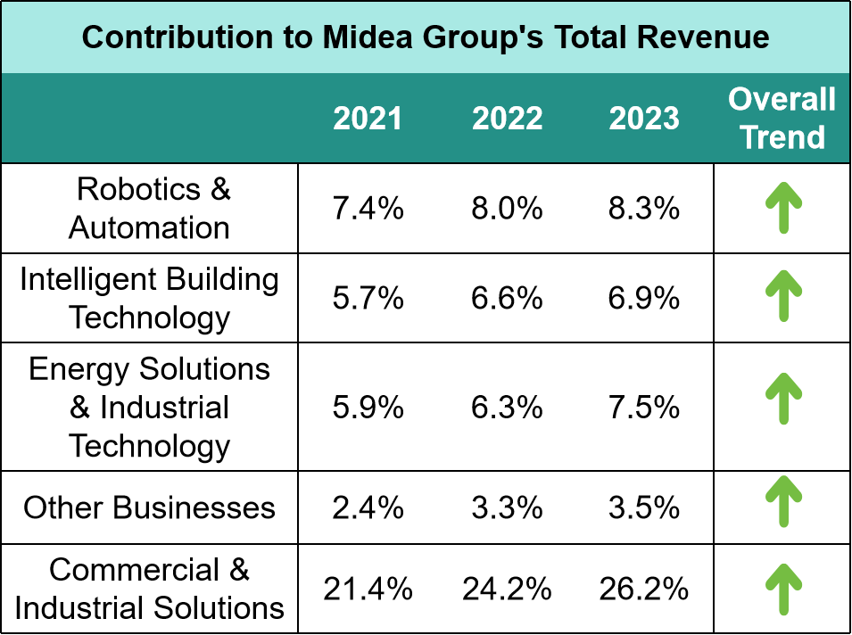
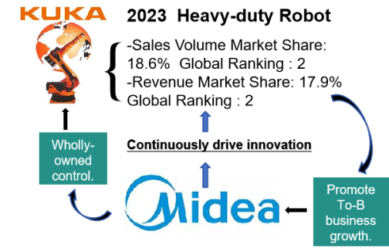
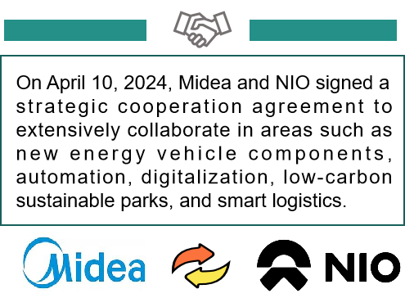
Investment Summary
Steady Growth in Smart Home Solutions
#1: Midea has Strong Global Competitiveness
Gross revenue growth rate
The "trade-in" policy has been successfully communicated to consumers
-Morgan Stanley's AlphaWise survey
#2: Midea has Continuous Business Revenue Growth Potential
Rapid Growth in Commercial & Industrial Solutions
Impressive performance of Commercial & Industrial Solutions could bring an upside surprise to Midea
#3: Midea has Exceptional R&D Innovation Capability
Contribution to total revenue : 21.4%(2021) ☞ 26.2%(2023)
OVERVIEW
THESIS #1
THESIS #2
THESIS #3
ESG
FINANCIALS
RISKS
VALUATION
APPENDIX

Slide 6
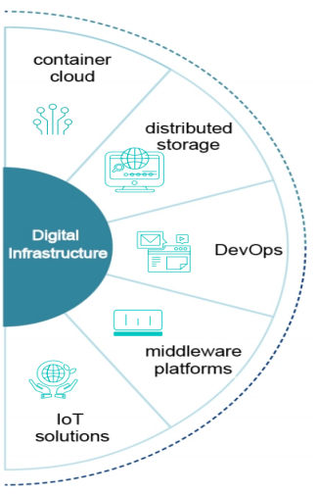
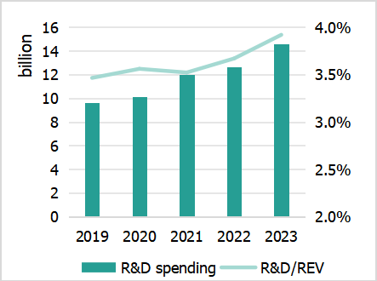
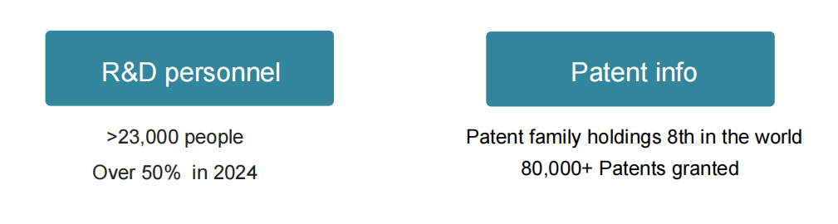


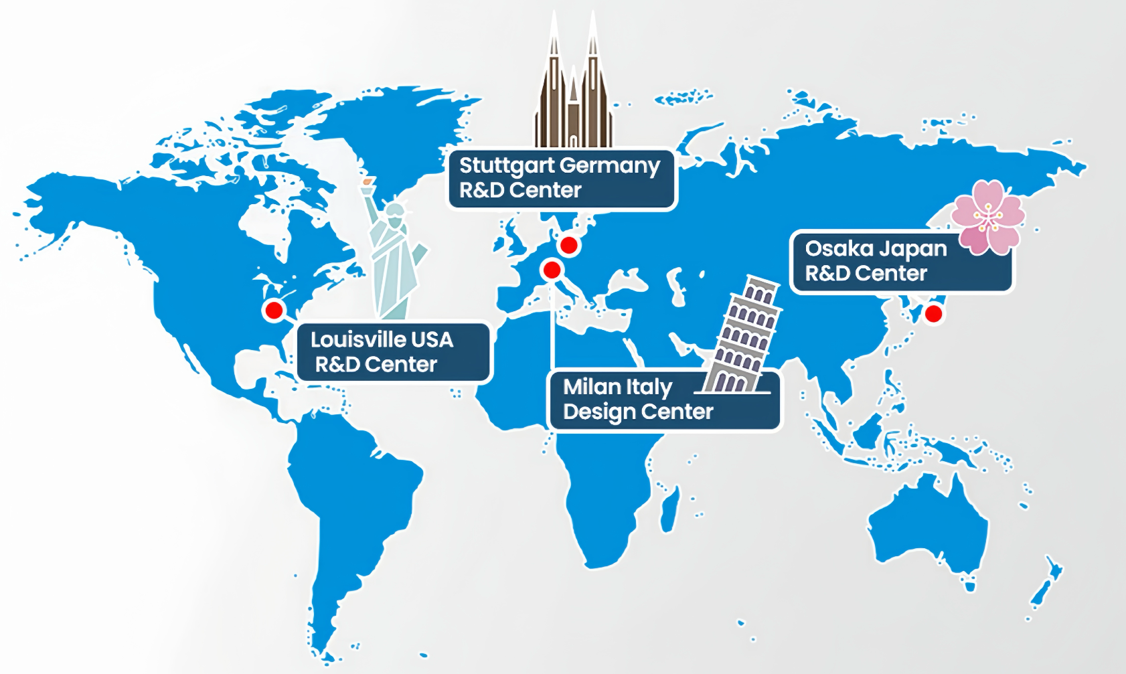
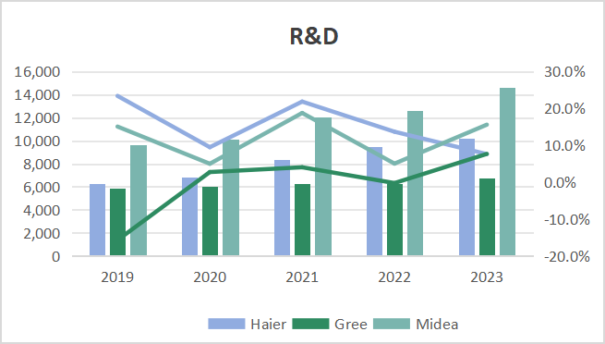
Investment Summary
R&D Investment :Nearly 60B CNY across 5 years
Comprehensive digital infrastructure
#1: Midea has Strong Global Competitiveness
Applying R&D outcomes to products
#2: Midea has Continuous Business Revenue Growth Potential
Enhancing quality and efficiency
Midea's investment in R&D leads the industry
#3: Midea has Exceptional R&D Innovation Capability
R&D Center Around World
OVERVIEW
THESIS #1
THESIS #2
THESIS #3
ESG
FINANCIALS
RISKS
VALUATION
APPENDIX

Slide 7
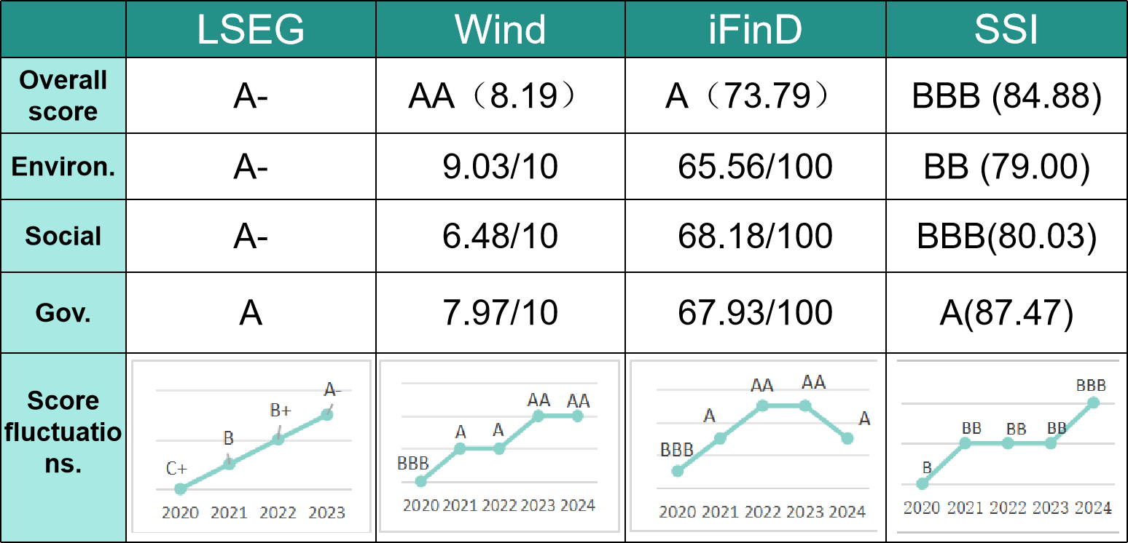
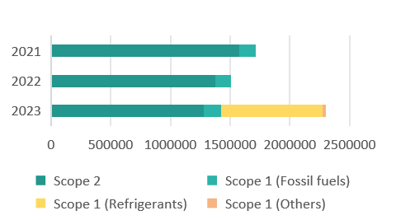
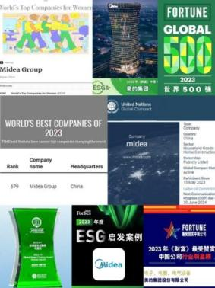
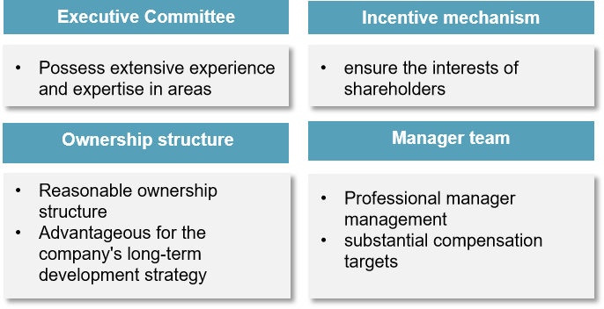
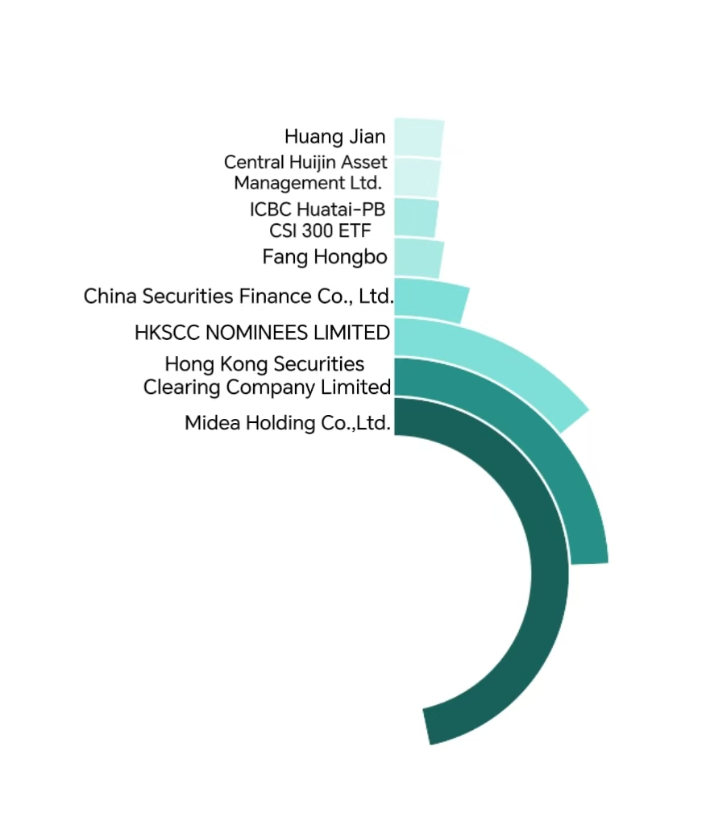
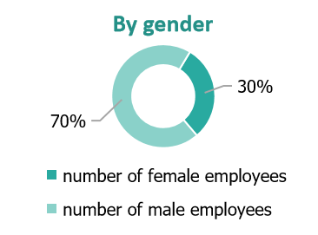
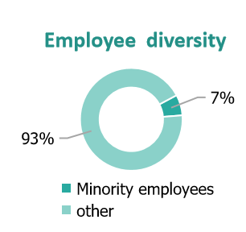
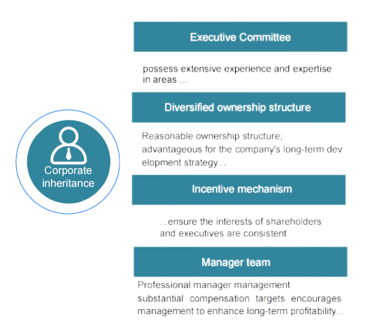
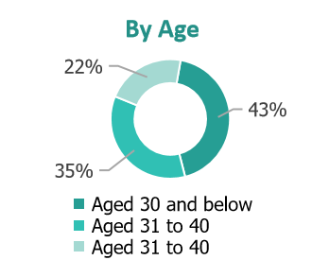
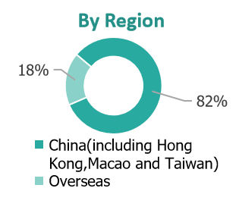
ESG
Awards and Scores
Actual carbon emissions reduced
Employee diversity
MISSION
Promote “3060”
strategy to achieve carbon peak by 2030 and carbon neutrality by 2060
Major Shareholders' Equity Position
Corporate Governance
OVERVIEW
THESIS #1
THESIS #2
THESIS #3
ESG
FINANCIALS
RISKS
VALUATION
APPENDIX

Slide 8
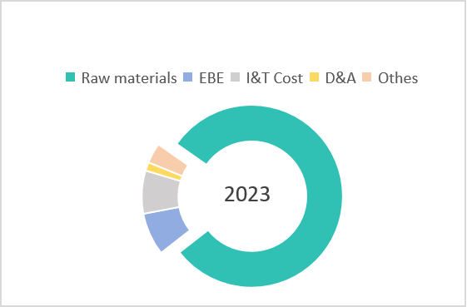
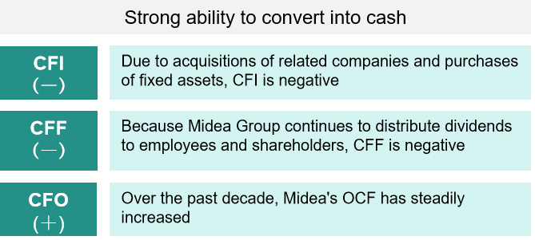


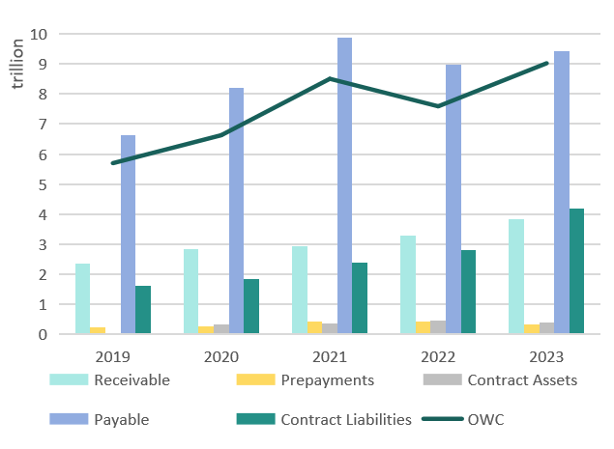
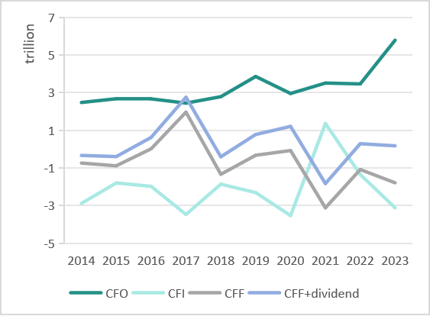


Financial Analysis
Risk Control and Stable Profits
Cash Flow Management
An Increase In OWC
Cost of Revenue
Rapid growth in contract liabilities
Operating Assets
Operating Liabilities
“1+2” strategy to mitigate risks
1
Economies of scale
Midea has ample cash
flow
Midea leverages its large-scale operations and resource sharing between businesses to centrally purchase raw materials in order to reduce costs
2
Two major hedges
Hedge raw material price fluctuations by using derivative instruments.
Hedge foreign exchange income using derivative instruments such as forward contracts and options
In 2023, Midea's EBIT was 36 billion, CFO was 58 billion, CFI was -31 billion, and CFF was -18 billion
cash cow
Midea has strong bargaining power
OVERVIEW
THESIS #1
THESIS #2
THESIS #3
ESG
FINANCIALS
RISKS
VALUATION
APPENDIX

Slide 9
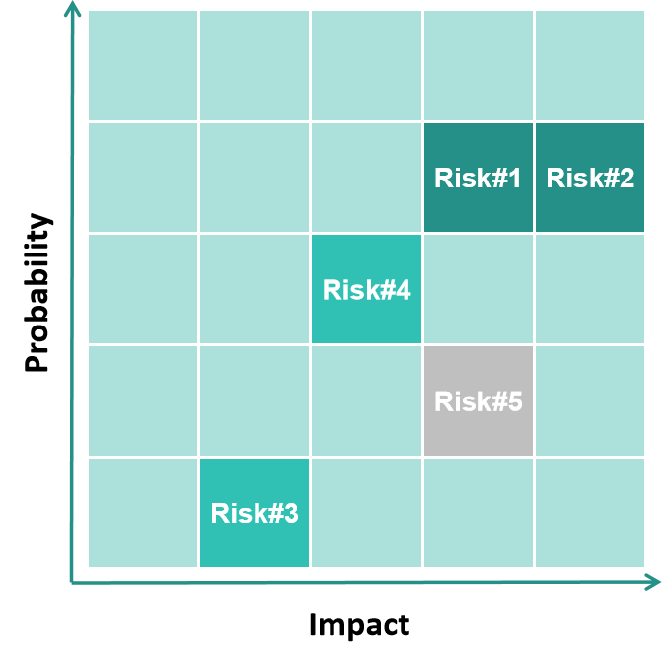
Investment Risks
Risk Matrix
Fluctuations in the real estate market （key）
downturn in the market incentive policies rising living standard
#1
Consumption downgrading （key）
consumption downgrading aging of the society
DEMAND
#2
#3
Fluctuations in raw material costs
price fluctuations in raw material
Risks Associated with Acquisitions
brand integration challenges goodwill impairment risk
SUPPLY
#4
Macroeconomic factors
exchange rate fluctuations unstable tariff policies the impact of international political volatility
#5
MACRO
OVERVIEW
THESIS #1
THESIS #2
THESIS #3
ESG
FINANCIALS
RISKS
VALUATION
APPENDIX

Slide 10
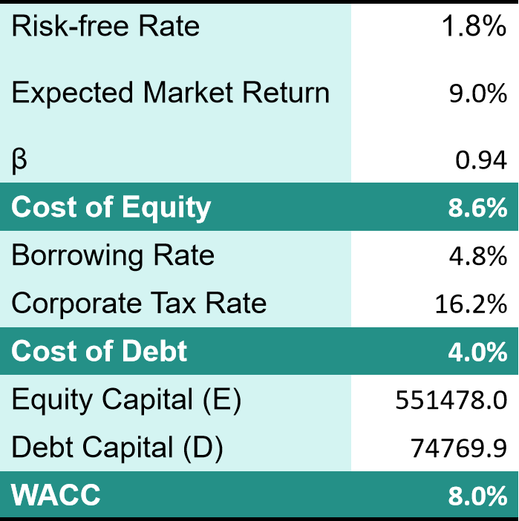
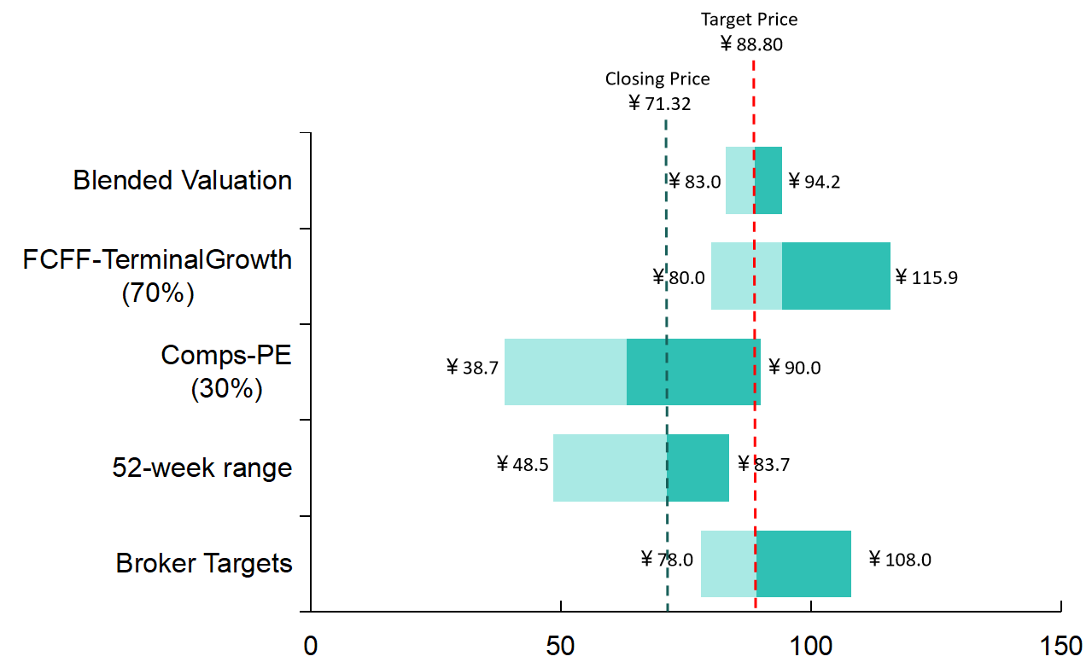
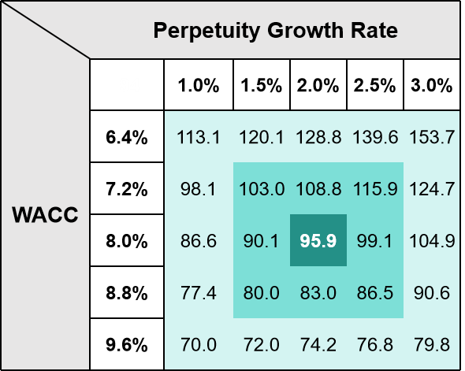
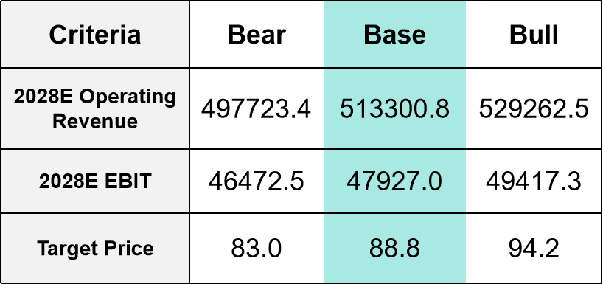
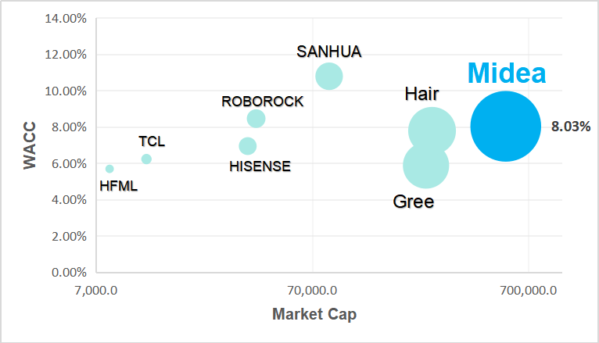
Valuation
We calculated a share price of ￥88.8 , a 24% increase from Midea's closing price on November 28 , 2024
We valued Midea using a blended approach consisting of absolute valuation ( 70%) and comparable companies analysis ( 30%)
Valuation Results
BUY
Sensitivity Analysis
Industry WACC
Current : ￥ 71.32
Target : ￥ 88.80
Scenario Analysis
OVERVIEW
THESIS #1
THESIS #2
THESIS #3
ESG
FINANCIALS
RISKS
VALUATION
APPENDIX

Slide 11
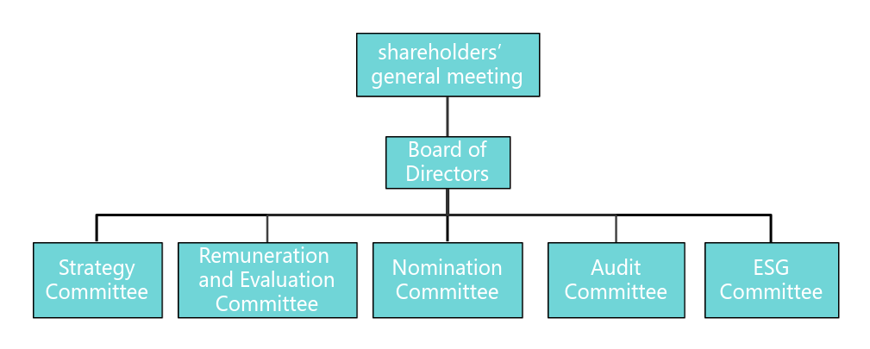
Appendix
Figure:Peer Scope 1 & 2 GHG emissions
Figure:Peer Female Staff Ratio
Figure: Peer ESG Ratings
Figure: CEO Compensation
Figure: Corporate Governance Framework
OVERVIEW
THESIS #1
THESIS #2
THESIS #3
ESG
FINANCIALS
RISKS
VALUATION
APPENDIX

Slide 12
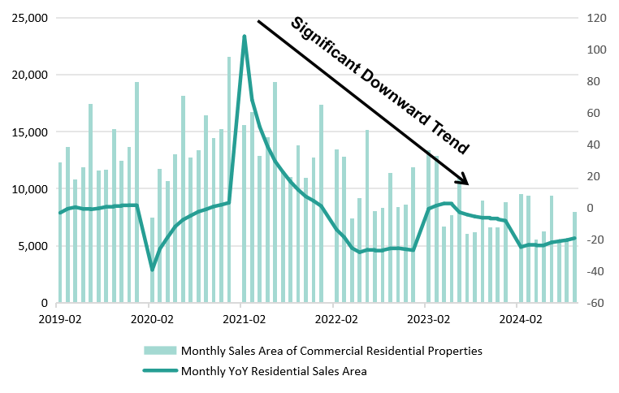
Appendix
Figure: Sales of Properties
Figure:Rooms in 2020/2023
Figure: Consumer Confidence Index
Figure: Birth Number&Dependency Ratio
Figure: Changes in Sales
Figure: USD/CNY in 2024
OVERVIEW
THESIS #1
THESIS #2
THESIS #3
ESG
FINANCIALS
RISKS
VALUATION
APPENDIX

Slide 13
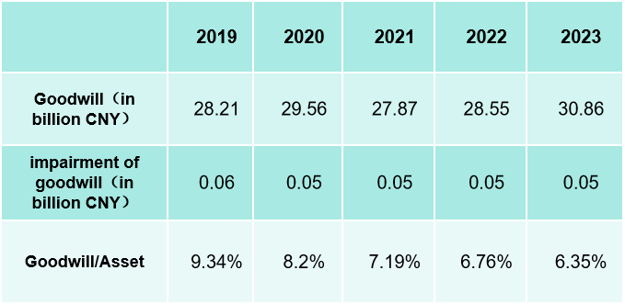
Appendix
Figure: PPI in China
Figure: Midea's Major Acquisition History
Figure: Midea’s goodwill
Figure: Spot Prices of Copper and Aluminum
OVERVIEW
THESIS #1
THESIS #2
THESIS #3
ESG
FINANCIALS
RISKS
VALUATION
APPENDIX

Slide 14
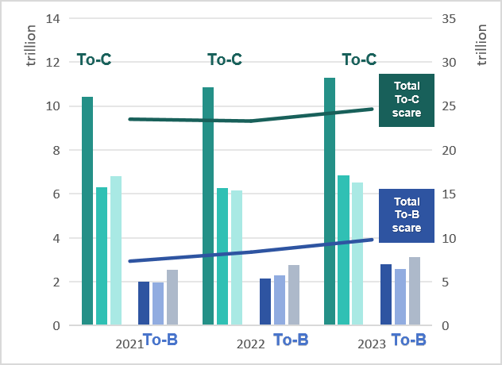
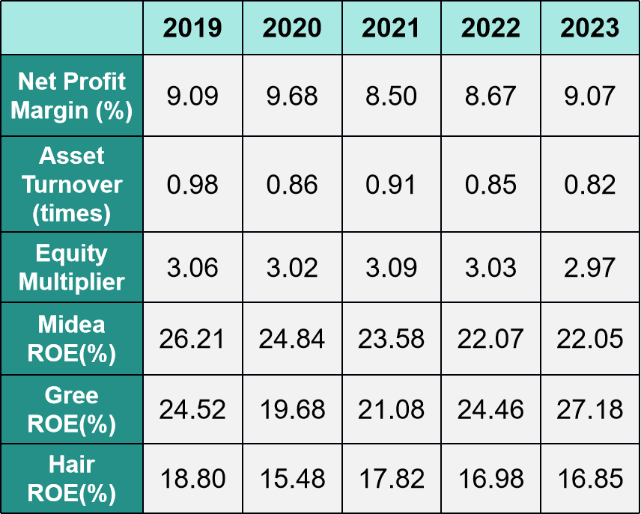
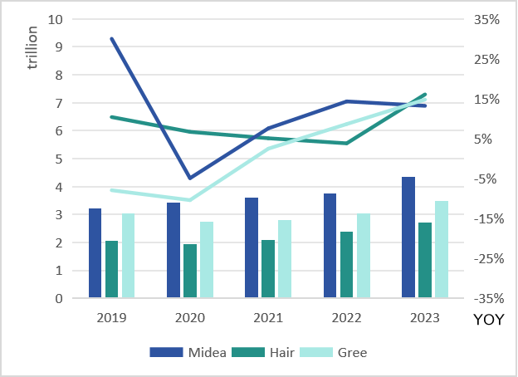
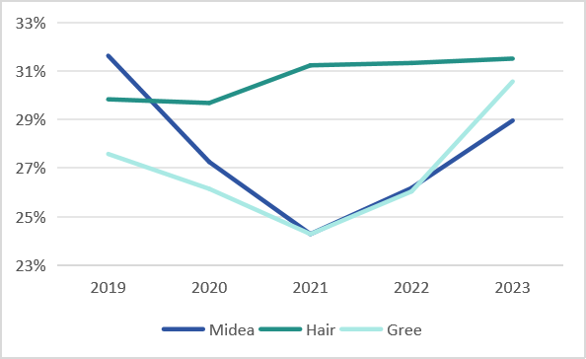
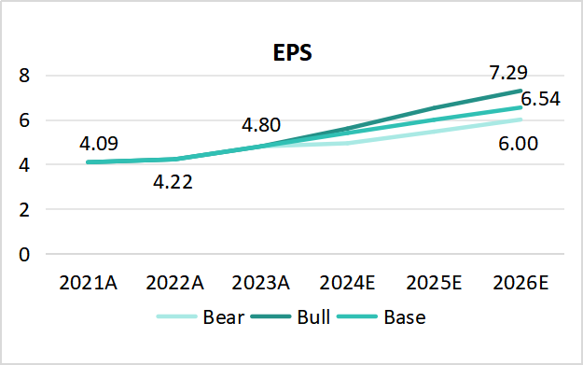
Appendix
Figure: Segment Revenue
Figure: ROE
Figure: EBITDA
Figure: Gross Margin
Figure: Dividend Situation
Figure: EPS Scenario Analysis
OVERVIEW
THESIS #1
THESIS #2
THESIS #3
ESG
FINANCIALS
RISKS
VALUATION
APPENDIX

